Slide 1


UAS RISKS
& countermeasures
АССОЦИАЦИЯ
АЭРОНЕТ
Форум «Технологии безопасности»
Moscow, 14 February 2018

Slide 2
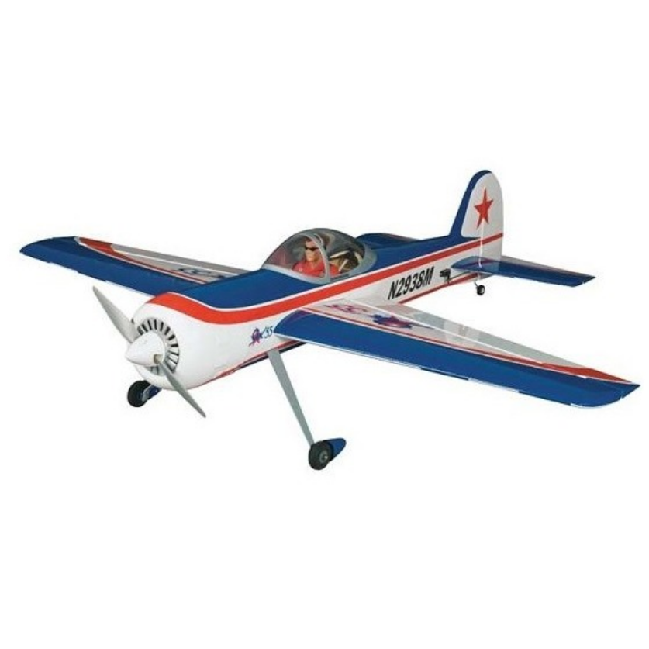
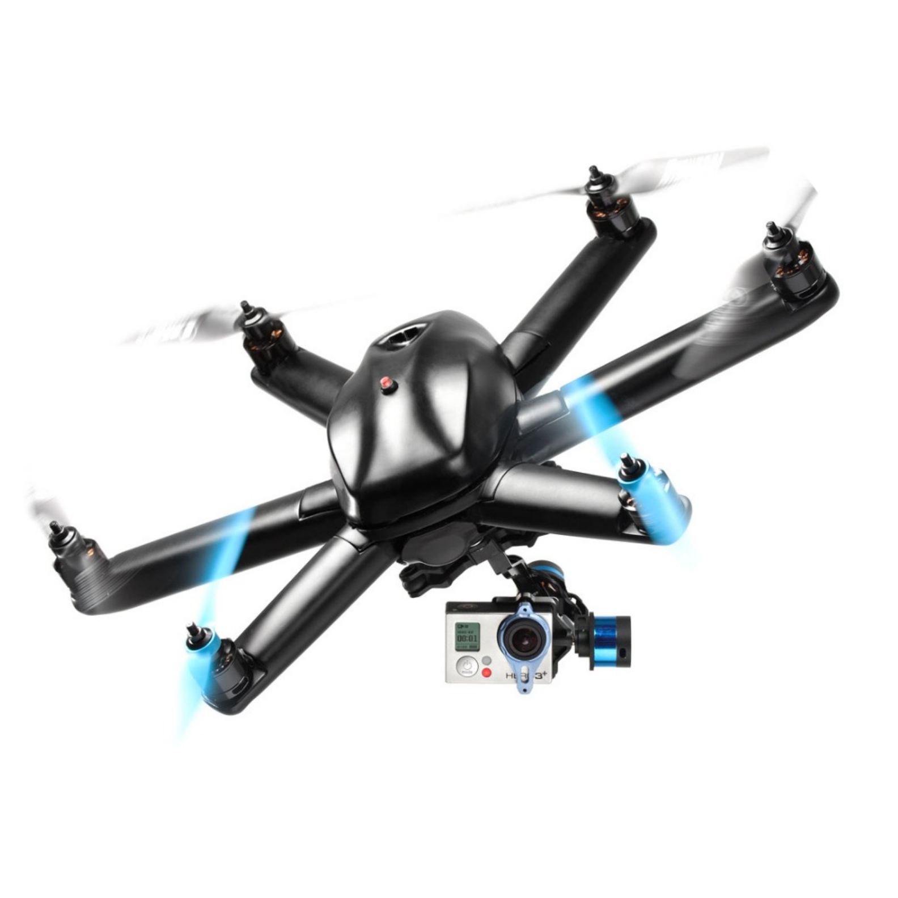
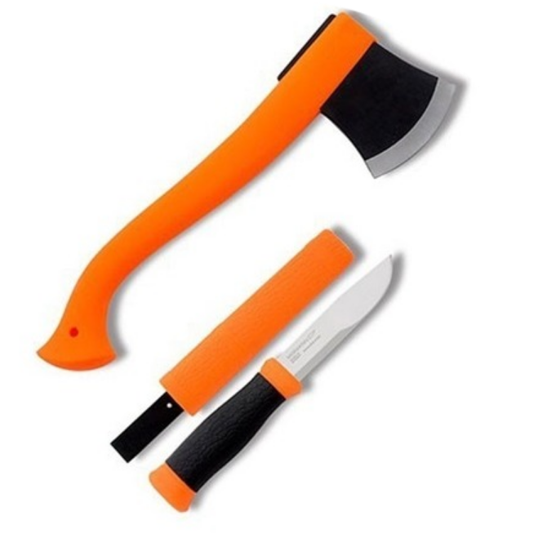
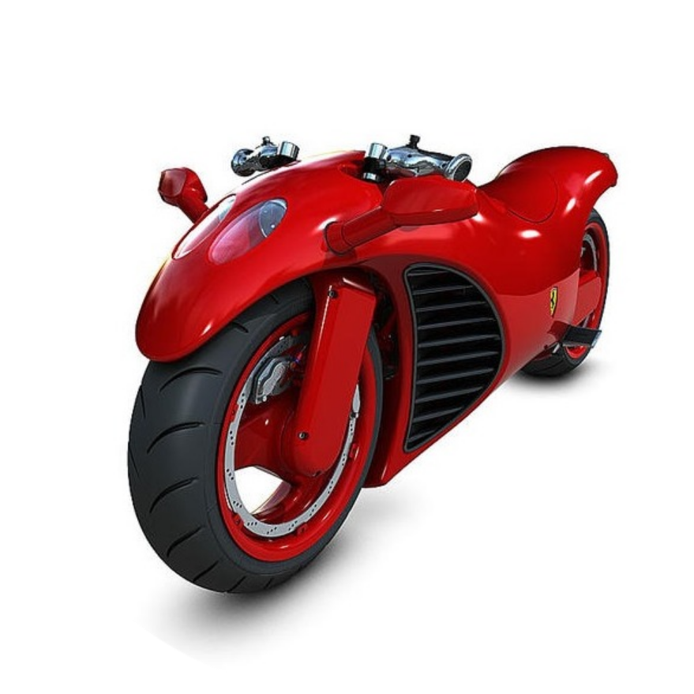

RISKY TECHNOLOGIES – DEVELOP OR RESTRICT ?

Slide 3
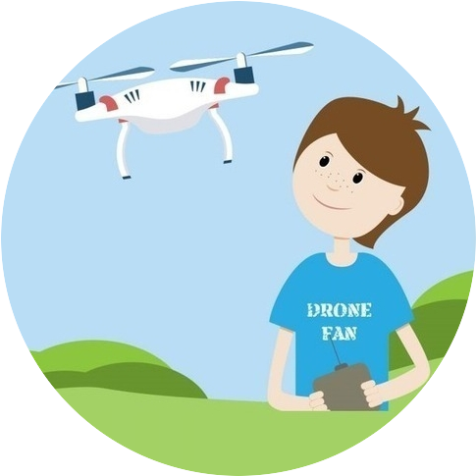
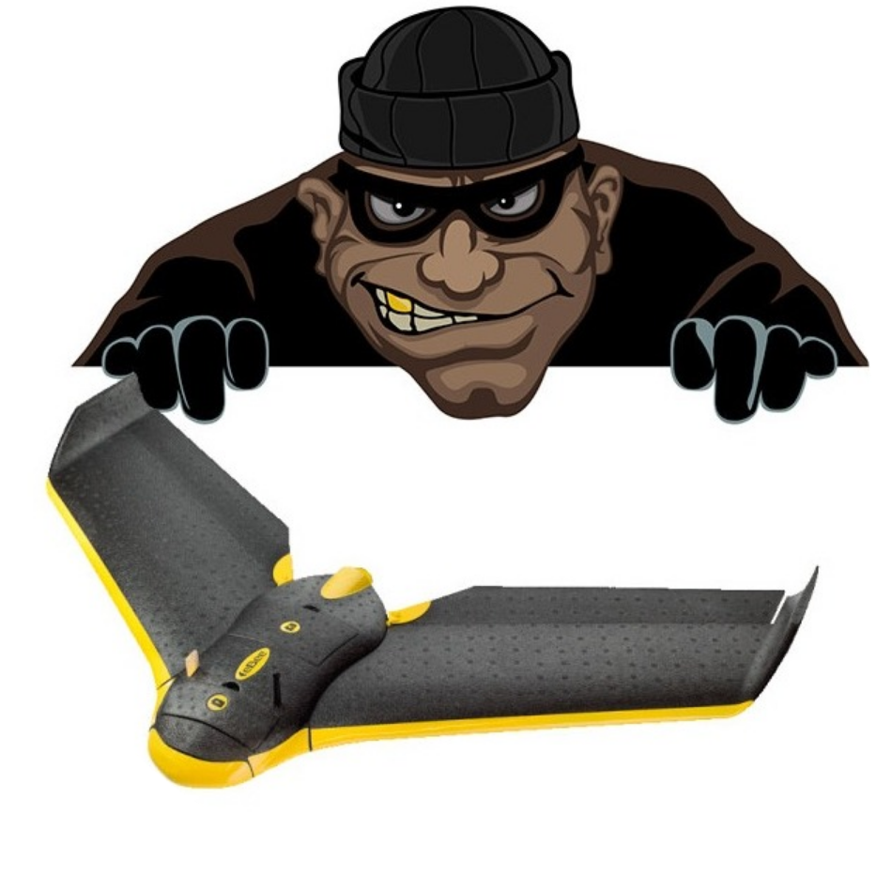
DRONES – ONLY TWO SOURCES OF RISK
Not intentional harm
Intentional harm
Неумышленный вред
Умышленный вред

Slide 4
DRONES – HARM REASONS
Not intentional harm
Intentional harm
TECHNICAL FAILURE
A CRIME
CARELESSNESS
IGNORANCE
Неумышленный вред
Умышленный вред

Slide 5
DRONES – HARM EFFECTS & COUNTERMEASURES
Not intentional harm
Lite law regulation is quite enough!
INSURANCE
A DRONE DOWN
RESPONSIBILITY
NO-FLY ZONE VIOLATION
LEARNING
PLANE COLLISION
TECHNICAL METHODS

Slide 6
DRONES – HARM EFFECTS & COUNTERMEASURES
Intentional harm
EXPLOSIVE DELIVERY
CERTIFICATION
PLANE ATTACK
REGISTRATION
CYBER ATTACK
LEARNING
Law regulation can’t help!

Slide 7
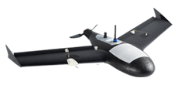

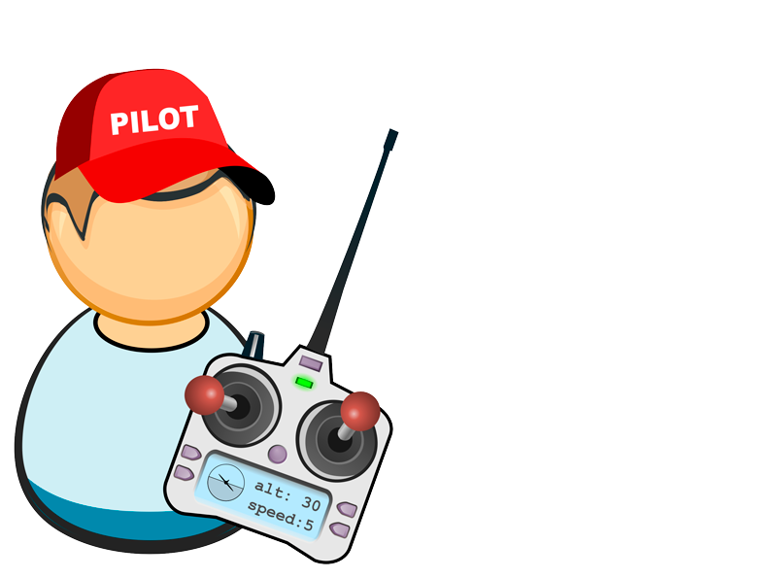
RISKS – NO-FLY ZONE VIOLATION
1. It is necessary to contact the Drone Pilot, who can stay anywhere far from no-fly zone;
2. It is necessary two pilots are able to communicate and control each other even without a dispatcher;
3. In the absence of communication and control, the unknown aircraft in red zone must be destroyed.

Slide 8
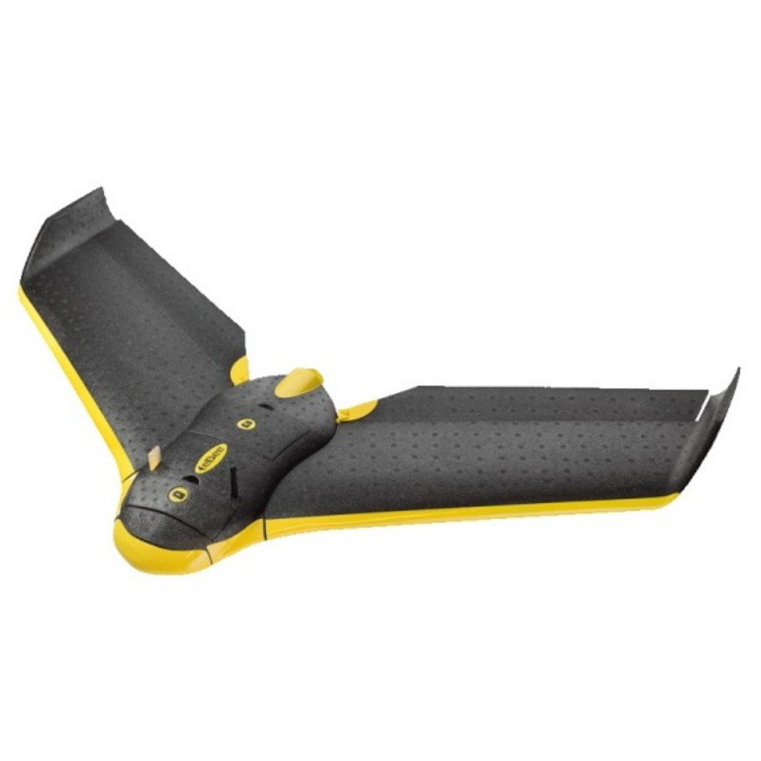
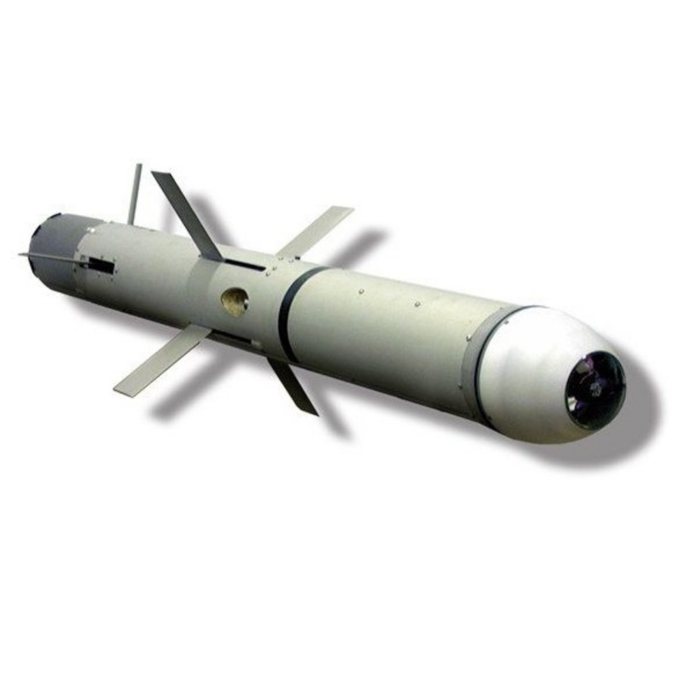
RISKS – EXPLOSIVE DELIVERY, PLANE ATTACK
-
-
+
+
CAN`T FLY WITHOUT ENGINES
R-WAVES ADDICTION FOR OPERATING
SMALL CHANCES TO DESTROY OBJECTIVE
PRICE - MEDIUM
CAN FLY SOME DISTANCE WITHOUT ENGINES
R-WAVES ADDICTION FOR OPERATING
SMALL CHANCES TO DESTROY OBJECTIVE
PRICE - LOW
CAN FLY LONG TIME WITHOUT ENGINES
R-WAVES INDEPENDENCE
BIG CHANCES TO DESTROY OBJECTIVE
PRICE -HIGH

Slide 9
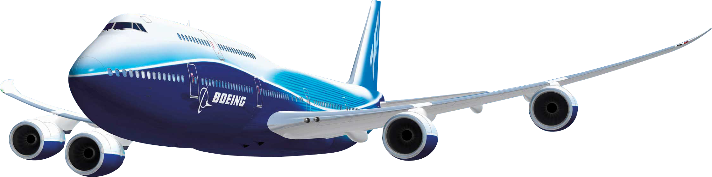
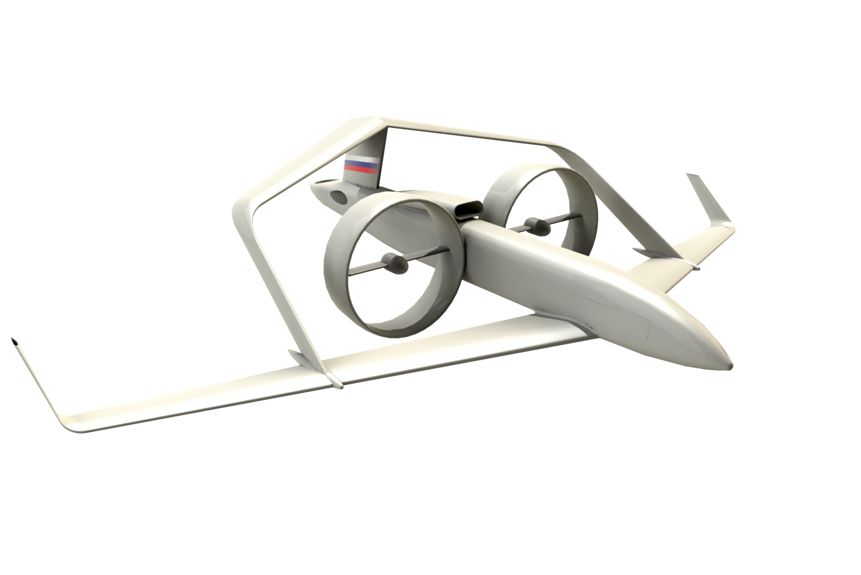

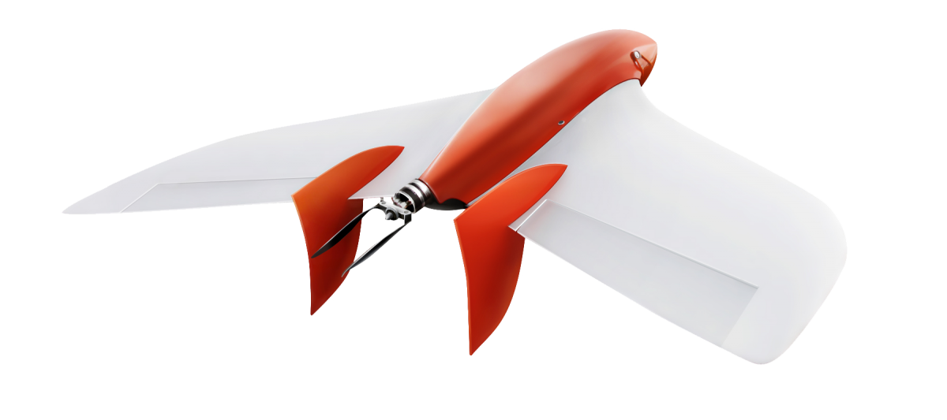
RISKS – CYBER ATTACK
INVISIBILITY HIGH EFFICIENCY LOW PRICE

Slide 10
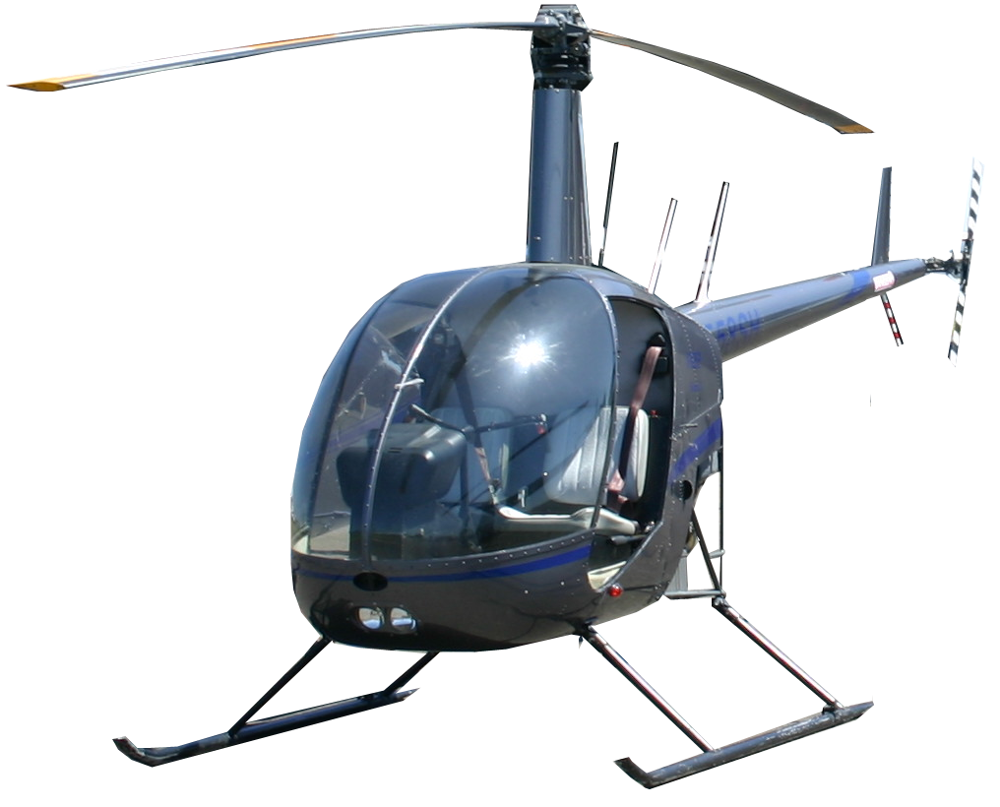
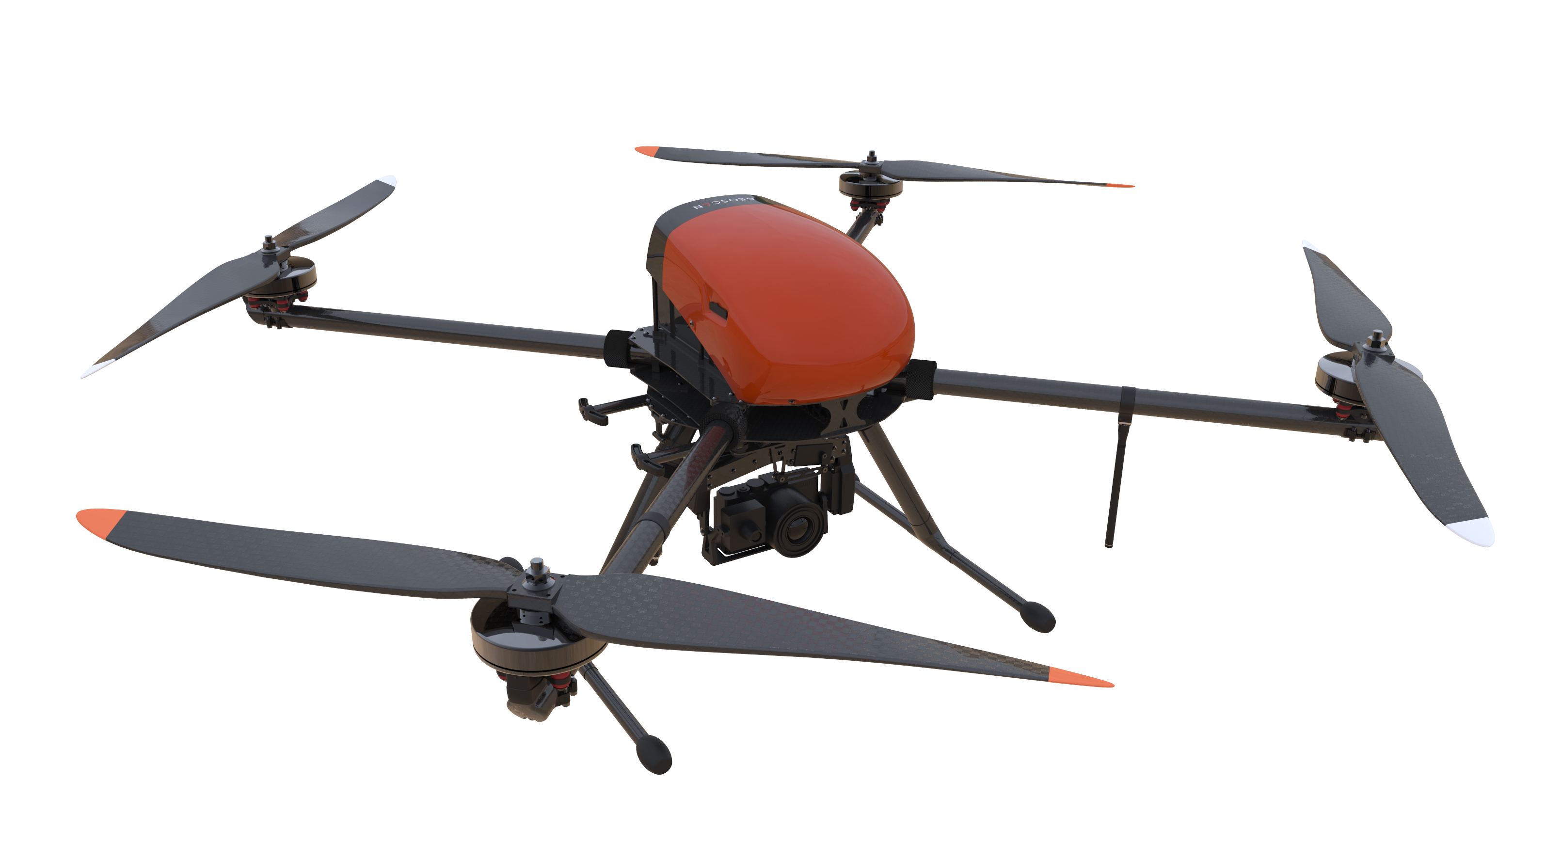
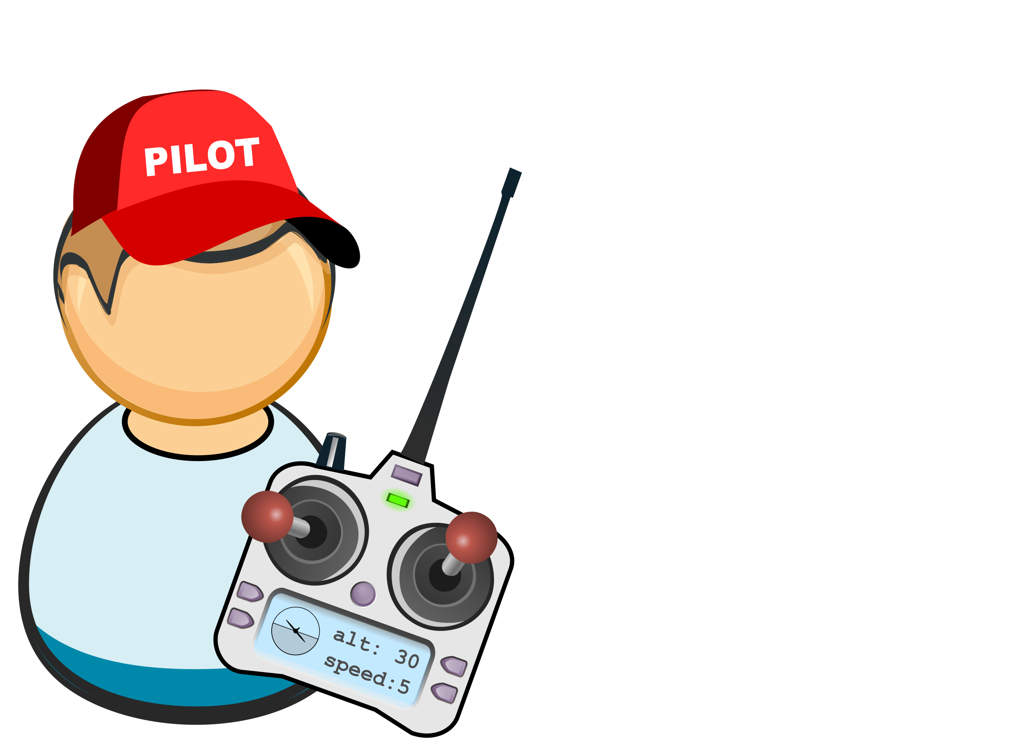
RISKS – CYBER ATTACK: EASIEST WAY TO ATTACK TODAY
1. All lines must be protected by cryptography;
2. All pilots must communicate and be visible to each other with or without a dispatcher.
3. All lines must be approved by IСAO;

Slide 11
THANK YOU!
АССОЦИАЦИЯ
АЭРОНЕТ
Форум «Технологии безопасности»
Moscow, 14 February 2018

